Slide 1
Traffic Control and Signal System Design HCS2000 Lab Training
2019 NSF RET Project
Faculty Mentor: Dr. Heng Wei, Professor
GRA: Raja Bharat Annam
annamrt@mail.uc.edu
6/19/2019

Slide 2
Download the lab files
Download the HCS lab package.

Slide 3
Overview of HCS
Highway Capacity Software (HCS) IS A Windows application implementing the procedures defined in the Highway Capacity Manual (HCM 2000).
It analyzes capacity and determines level of service (LOS) for:
Signalized Intersections,
Unsignalized Intersections,
Urban Streets (Arterials),
Freeways,
Highways,
Transit,
…

Slide 4
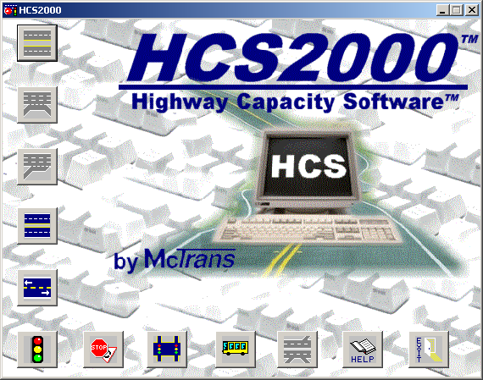
Getting Started
Locate the program at c:\\HCS2000;
Click the logo ;
We will focus on the function module of: Signalized intersection.

Slide 5
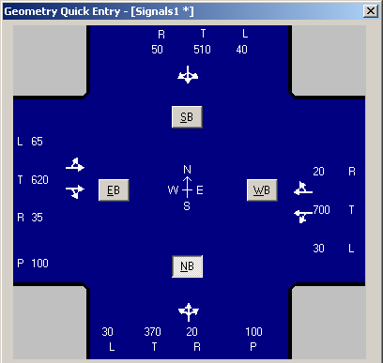
Example 1. Chapter 16. P16-38
Delay and peak hour L.O.S.?
Analysis type = Operations
Geometry = quick entry
Volume = left figure or P16-42
Pedestrian = 100 p/h
pedestrian travel distance = 30 feet (E/W) and 44 feet (S/N)
Crosswalk width = 10 ft
PHF = 0.9
Arrival Type: EB = 4, WB =2, NB&SB = 3
Start lost time = 4 s
Phase design

Slide 6
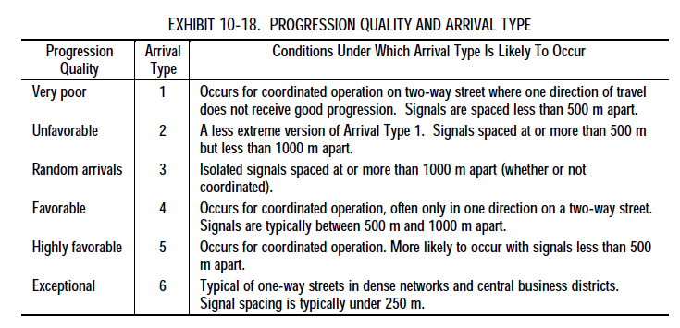
Arrival Type

Slide 7
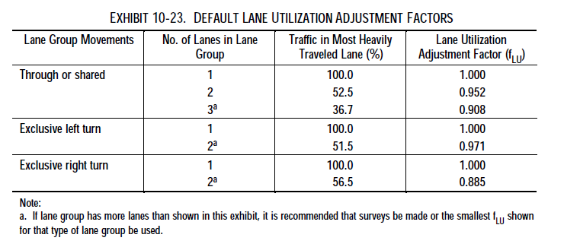
Lane Utilization

Slide 8
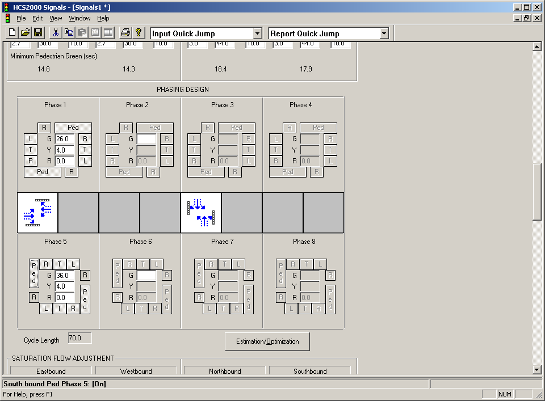
Example 1. Chapter 16. P16-38
Peak hour L.O.S.?
Phase design

Slide 9
Example 1. Chapter 16. P16-38
Saturation flow adjustment:
Base saturation flow rate = 1,900 pc/h/ln
Lane width: EB, WB = 11 ft ; SB ,NB = 15 ft
HV percentage: EB, WB = 5%; SB ,NB = 8%
Bikes: 20 bikes/h

Slide 10
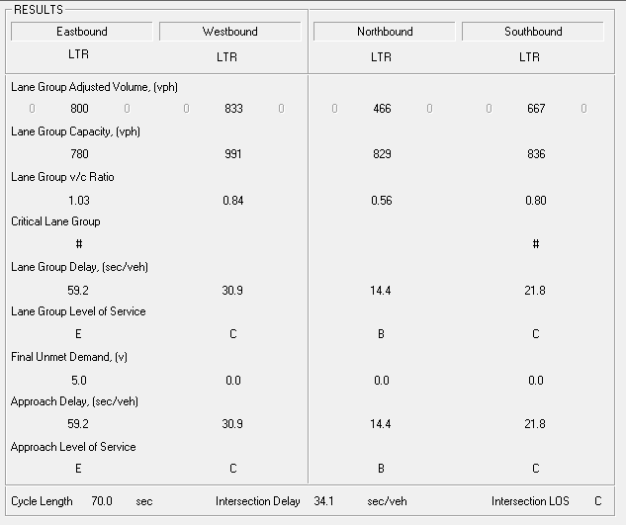

Slide 11
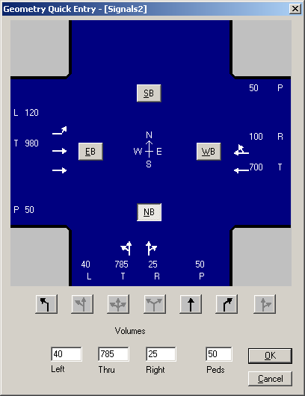
Example 2. Chapter 16. P16-48
Delay and Peak hour L.O.S.?
Analysis type = Operations
Geometry = quick entry
Volume = left figure or P16-58
Pedestrian = 50 p/h
Pedestrian travel distance = 60ft (E/W) and 44 ft (N/S)
Crosswalk width = 10 ft
PHF = 0.95
Arrival type = 3
Start lost time = 4 s
Phase design (next page)

Slide 12
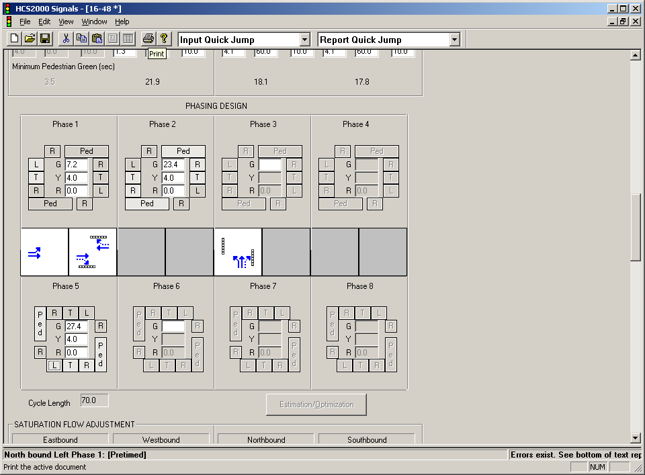
Example 4. Chapter 16. P16-38
Peak hour L.O.S.?
Phase design

Slide 13
Example 2. Chapter 16. P16-48
Delay and Peak hour L.O.S.?
Base saturate flow = 1,900
Lane width: 12 ft
HV percentage: EB, WB = 10%; SB ,NB = 5%
NB grade = - 2%
NB parking = 20 maneuvers/h
EB / WB bus stopping = 20 b/h
Bike: 20 bikes/h

Slide 14
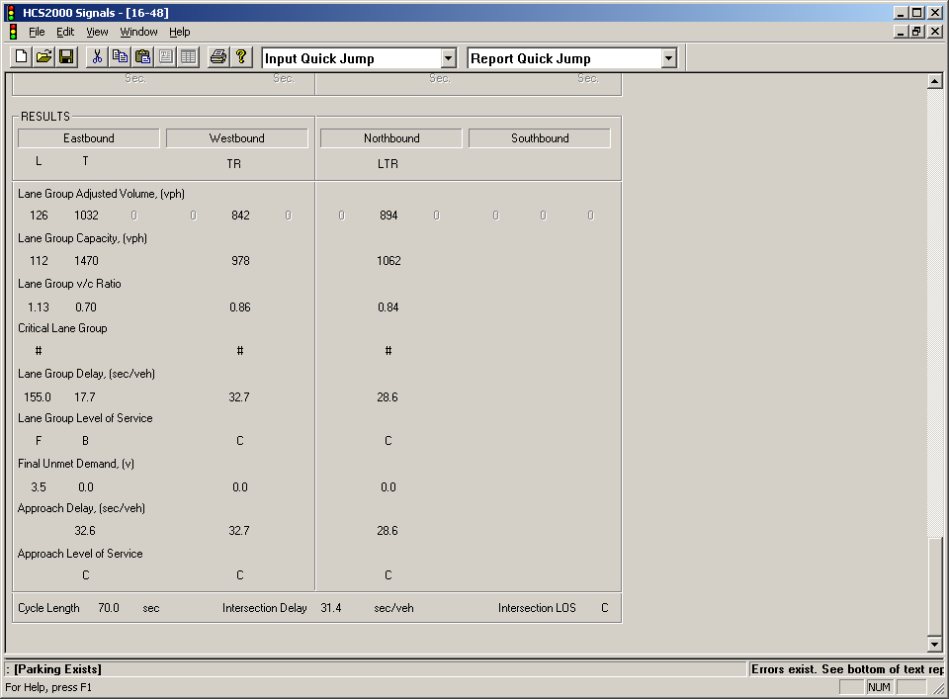

Slide 15
Example 4. Chapter 16. P16-74
Delay and Peak hour L.O.S.?
Analysis type = Planning
Geometry and volume
PHF = 0.90
Cycle length = 90 s to 120 s
Start lost time = 4 s
Phase design (next page)

Slide 16
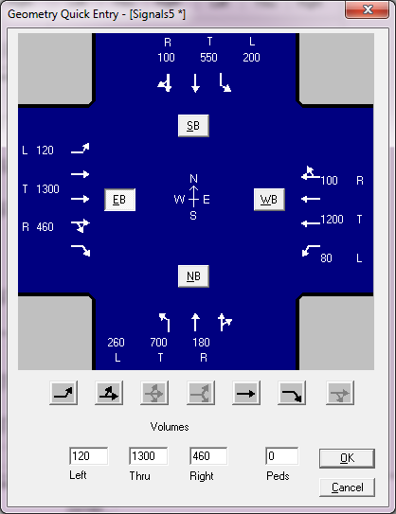
Example 4. Chapter 16. P16-74
Add an exclusive EB right turn lane and other inputs do not change.
Analysis type = Operations
Geometry and volume = right figure
PHF = 0.90
Start lost time = 4 s

Slide 17
Example 4. Chapter 16. P16-74
Update the signal phasing and timing plan

Slide 18
Example 4. Chapter 16. P16-38
Update the signal phasing and timing plan

Slide 19
2019 NSF RET Project
Questions
18
Notes:
18
KPF design Shanghai World Financial Center
SOM Jin Mao Tower
PB Residential buildings
MG2 Commercial buildings

